Slide 1





Podesoro Group
SUPERBOWL ADS PROJECT
A PROJECT PRESENTATION BY:
Mercy Mulwa
Angela Ngatia
Victoria Gitonga
Nduti - Technical Mentor
Data Analysis

Slide 2

Agenda
Introduction
Problem Statement
Implementation process (sql % tableau)
Next steps for the project

Slide 3



Introduction % Problem Statement
Why Superbowl Ads Project?
We chose The Superbowl Ads Project in an attempt to discover if the costly ads are worth it to the advertisers.
Problem statement:
A beverage brand named Atom is looking to place an advertisement during the superbowl. In preparation for this, they hired Team Poderoso to leverage superbowl advertisement datasets and provide useful insights that they can use while creating their ad.

Slide 4
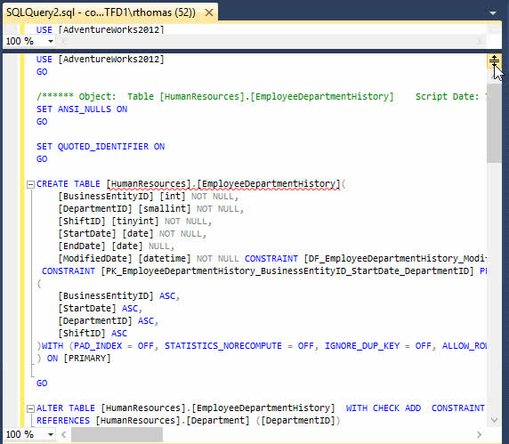
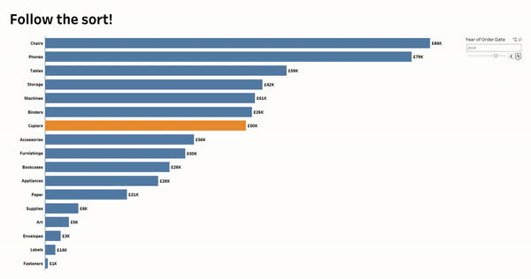

SQL
TABLEAU VISIULIZATION
Implementation Process
Data Source: An article by Ulrik Thyge Pedersen
https://www.kaggle.com/datasets/ulrikthygepedersen/superbowl-ads/data

Slide 5





SuperBowl Ads Future
CELEBRITY # 1
People are more likely to follow celebrities that are cheaper to host on the show
Next Steps?
FUNNY # 2
Ads will be less funny
CELEBRITY VS ANIMALS # 3
Ads will involve more celebrities and less animals

